Slide 1
2017 Supplier Summit
Global Sourcing Home Contacts:
General mailbox: DirectGlobalSourcing@kroger.com
Tony Yan: Sr. Manager – Global Sourcing General Merchandise Kroger Co. Tony.Yan@Kroger.com
Greg Ho: Manager - Global Sourcing for Home
Greg.Ho@Kroger.com
Eun Hwang: ASP - Global Sourcing General Merchandise Kroger Co. Eun.Hwang@kroger.com

Slide 2
Product Inspection Kroger Home team’s expectations:
Li & Fung’s vendors are exempted. Please follow Li & Fung’s QC Policy.
Do not confuse Sourcing’s Product inspection with the Compliance team’s Factory Social Compliance or BV’s Product safety testing.
Vendor to work closely with Kroger Product Developers on “Our Brand” products to review and approve pre-production sample standard.
Vendor to perform their raw material inspections and multiple inline inspections at key stages of the production line to ensure all product match pre-production sample standard.
Vendor should use General Inspection Level 2 to determine sample size and AQL (Acceptance Quality Limit) should be set at 0% for critical, 2.5% for major and 4.0% for minor defects.

Slide 3
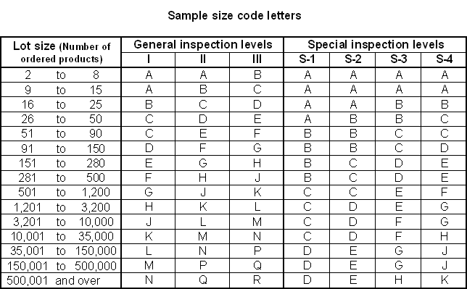
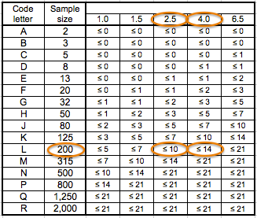
AQL Tables: Sample size code letters & AQL allowed

Slide 4
Ready to pack! Now, what?

Slide 5
Option #1 Hire 3rd Party, SGS, to do the Inspection
Please email DirectGlobalSourcing@kroger.com your intent of using SGS. Please also include quote sheet, PO ship date and order quantity information in your email.
The Global Sourcing Manger for Home will review your product and provide SGS contacts and further instructions.
In order to receive a “Pass” rating with SGS, you will need to submit an approved sample that was signed by Product Developer during your product approval.
If you plan to use a different 3rd party inspection company, please email DirectGlobalSourcing@kroger.com for approval.
SGS will send the final audit result to the Global Sourcing Manager and copy the vendor.
The Home Sourcing team will then follow up with additional comments within 3 business days.

Slide 6
Option 2: In-house inspection by vendor
No change on Production samples process with Product Developers.
Prior to your production, please send an example of your in-house inspection report to DirectGlobalSourcing@kroger.com. This item should be a similar product type that Kroger is buying.
E-mail subject line should read “Home – (Vendor name), (Product Type), in-house QC inspection report approval request-MMDDYY”.
This inspection needs to be an actual inspection previously performed and not a blank file. We expect you to cross off/delete any proprietary and customer information. We are mainly reviewing your protocols and see where your QCs are focusing on.
If your inspection protocols and format meet our requirements, we will grant you to perform your own Final Inspection. You should have our ruling within 14 days.
Vendor’s Letter of Quality Guarantee will be required.

Slide 7
Submitting in-house Final Inspection Report to Global Sourcing
First and foremost, you must have a “Passed” BV’s product safety compliance report before Kroger will accept your shipment.
Send Final Quality inspection Report to DirectGlobalSourcing@kroger.com File name should be “YYYY MM DD – FM (or KGM) PO #____, SKU #_____ Inspection Report”.
Send quote sheet and vendor’s Letter of Quality Guarantee to the same mailbox.
Quote sheet's file name should contain product item number and a brief product description.
Letter of Quality Guarantee’s file name should contain each PO # or by buying season or full calendar year.
Mail size should be less than 10MB per email. If your inspection report exceeds this size, please break them into multiple parts.
Our goal is to review and comment within 3 business days.

Slide 8
Once Sourcing approved your Inspection report, let them sail!

Slide 9
Global Home Sourcing team will perform random product inspection

Slide 10
What if product failed Sourcing’s in-store inspection?
Let’s hope this will not happen. We take no pleasure having to address vendor’s falsify inspection report.
If it was determined by Sourcing that this is a gross negligence and an intentional act by vendor, penalty could be any or all of the followings:
1) Vendor to lose its privilege of self-inspection.
2) Sourcing to recommend buying team to pull off the shelves if we deem product’s quality do not meet Our Brand’s standard and requirement.
3) Buying team to issue charge back for lost of sales based on end of season sell thru percentage for the category.
4) Sourcing to charge back vendor any store labor incurred.

